Slide 1
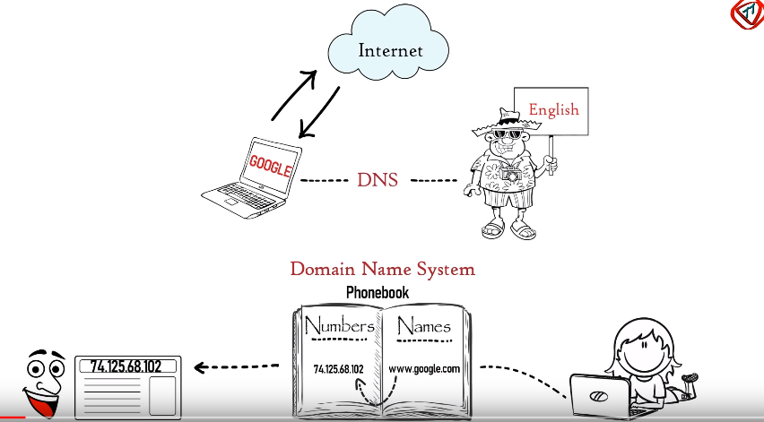
DNS: Domain Name System

Slide 2
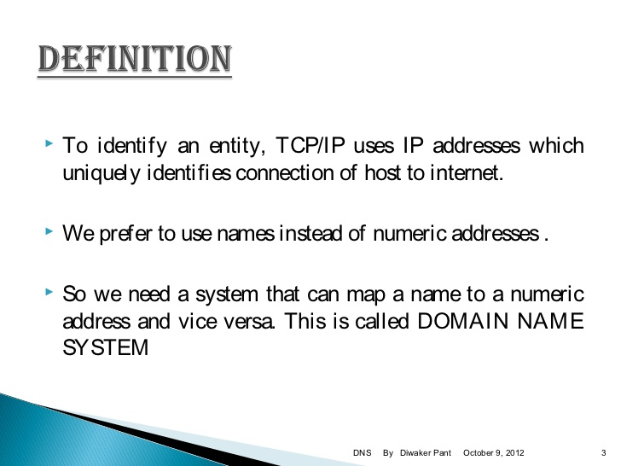

Slide 3
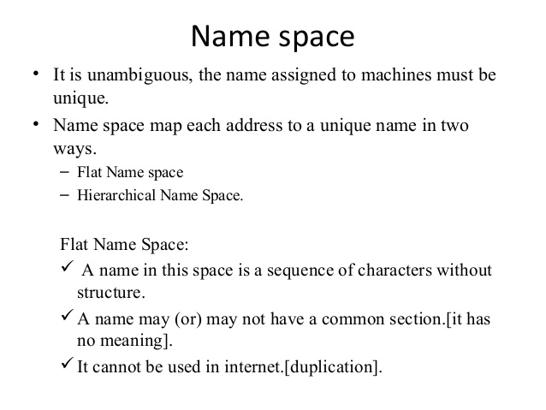

Slide 4
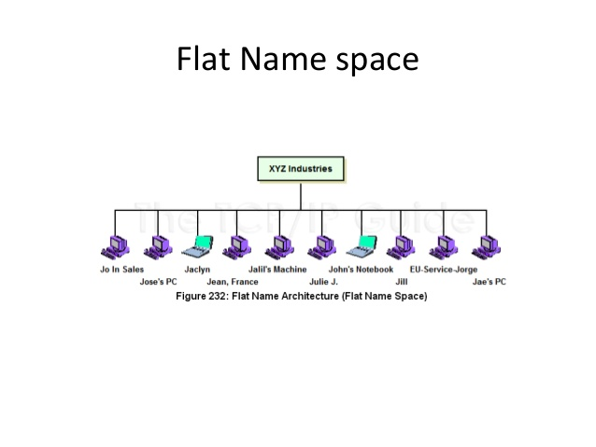

Slide 5
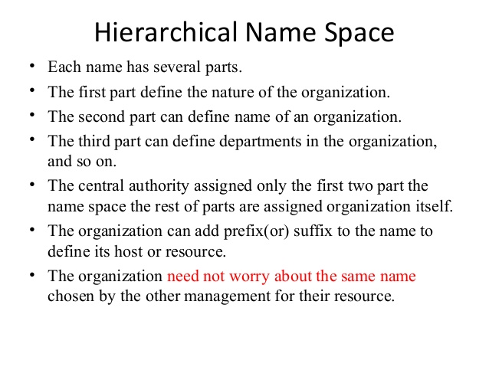

Slide 6
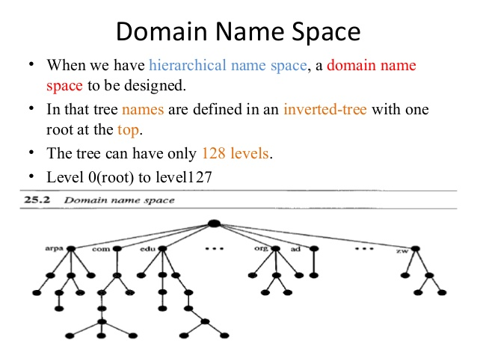

Slide 7
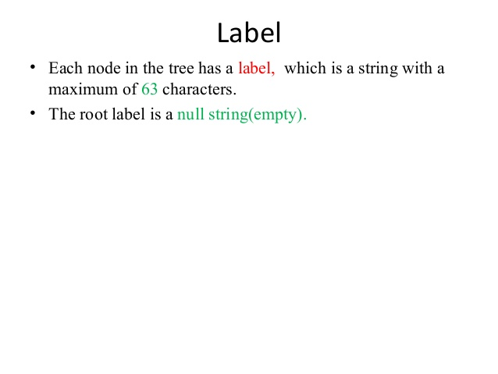

Slide 8
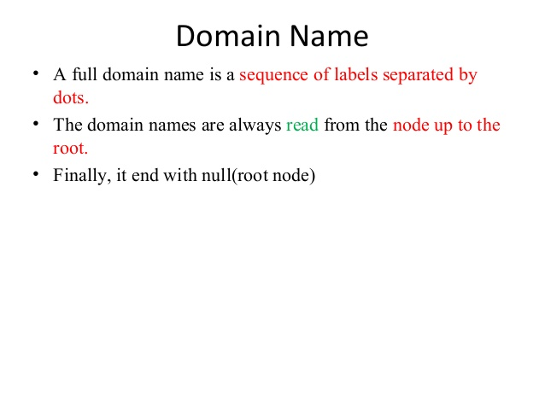

Slide 9
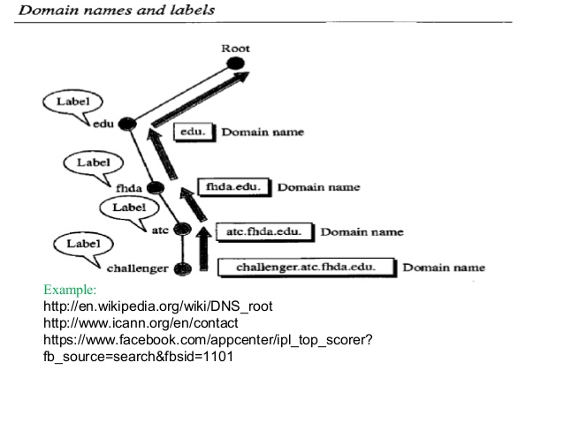

Slide 10
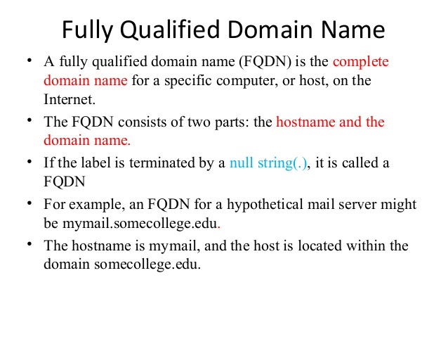

Slide 11
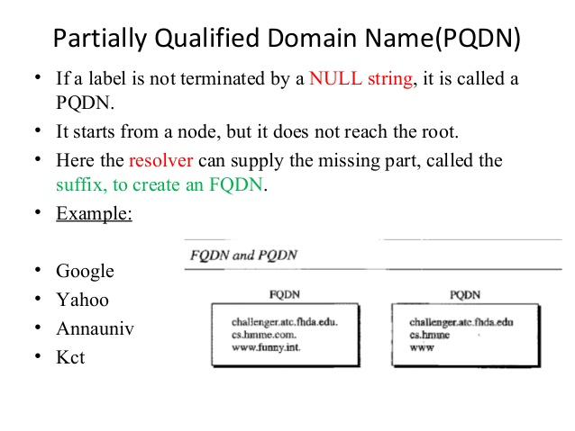

Slide 12
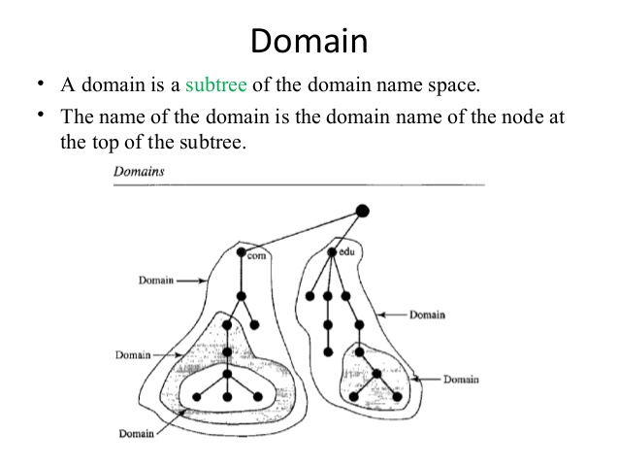

Slide 13
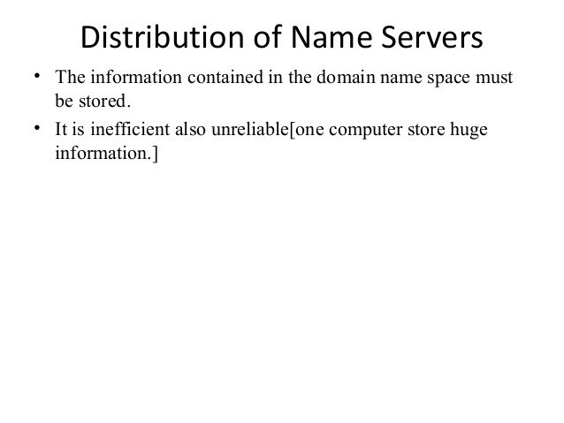

Slide 14
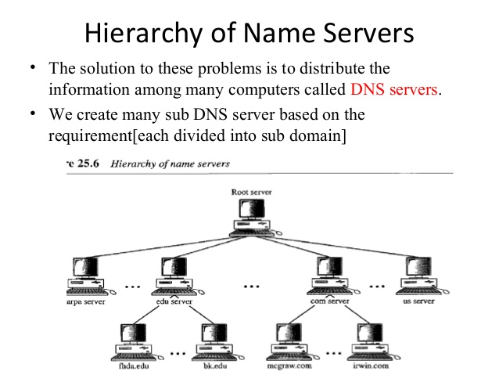

Slide 15
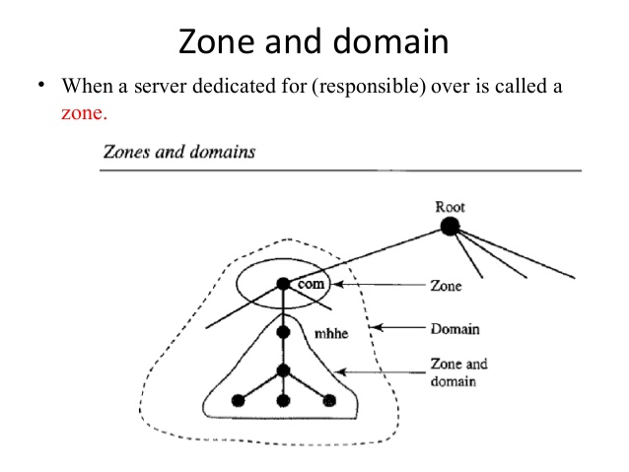
Zone and domain
What a server is responsible for, or has authority over, is called a zone.

Slide 16
We can define a zone as a contiguous part of the entire tree.
If a server accepts responsibility for a domain and does not divide the domain into smaller domains, the domain and the zone refer to the same thing.
The server makes a database called a zone file and keeps all the information for every node under that domain.
However, if a server divides its domain into subdomains and delegates part of its authority to other servers, domain and zone refer to different things.
The information about the nodes in the subdomains is stored in the servers at the lower levels, with the original server keeping some sort of reference to these lower-level servers.
Of course the original server does not free itself from responsibility totally: It still has a zone, but the detailed information is kept by the lower-level servers.

Slide 17
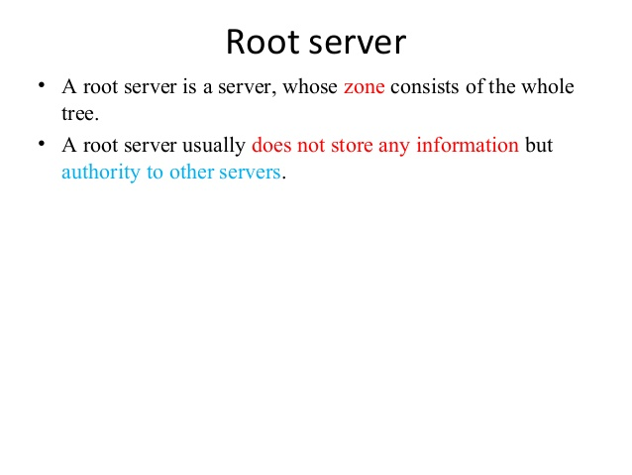

Slide 18
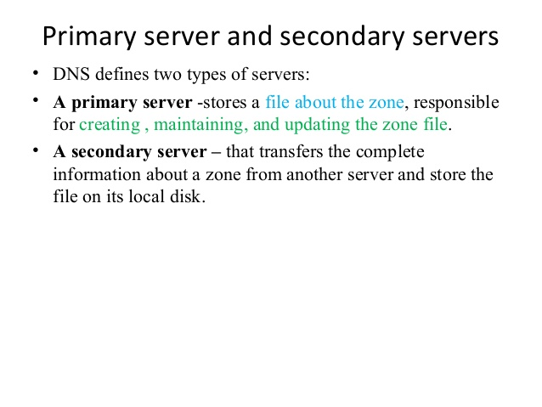

Slide 19
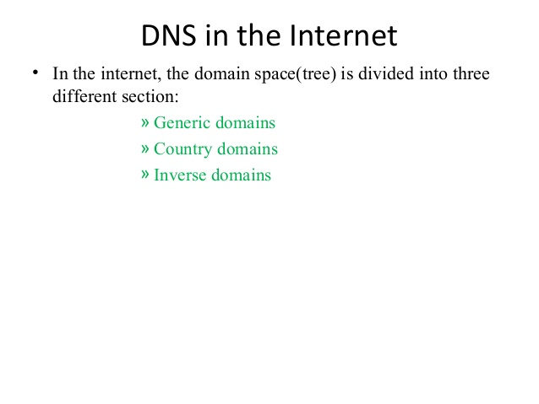

Slide 20
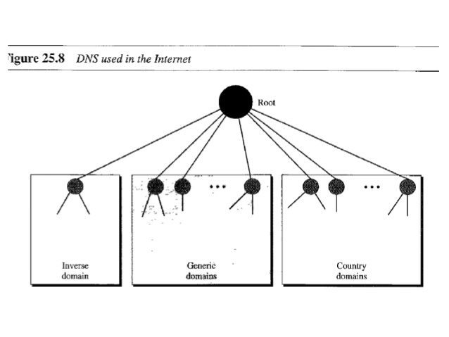

Slide 21
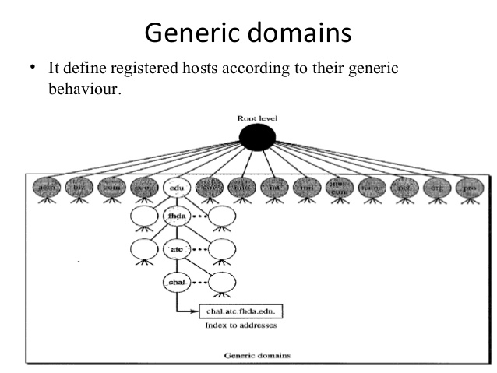

Slide 22
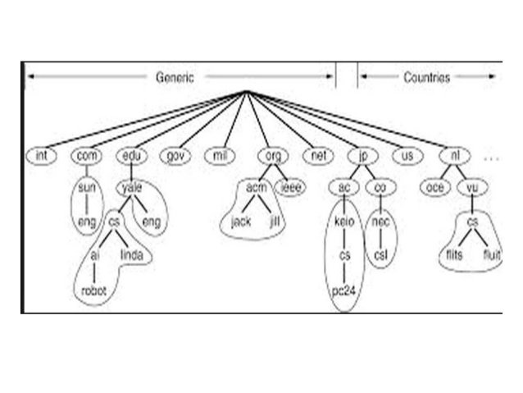

Slide 23
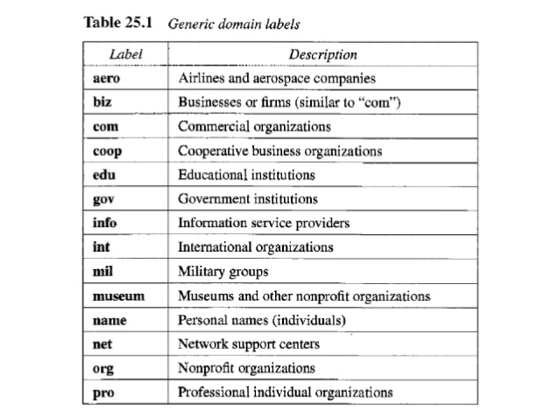

Slide 24
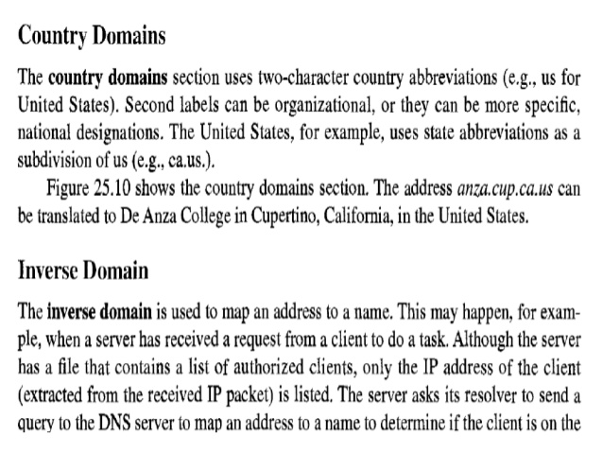

Slide 25
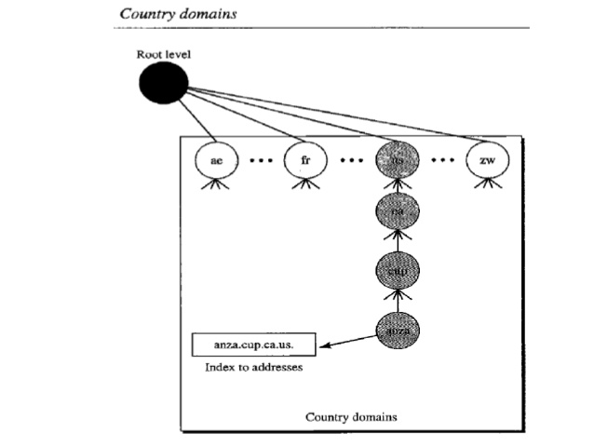

Slide 26
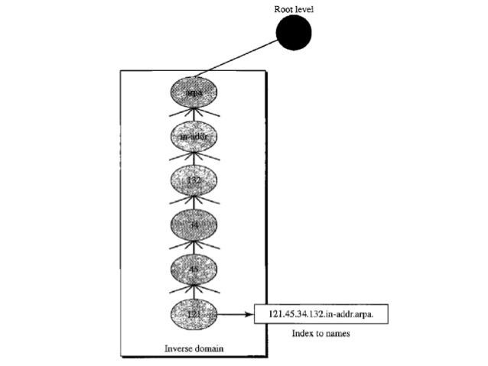

Slide 27
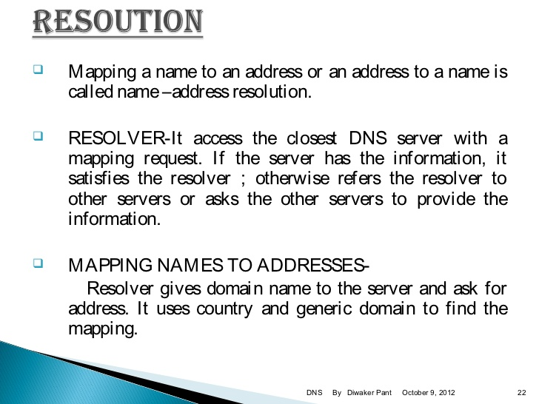

Slide 28
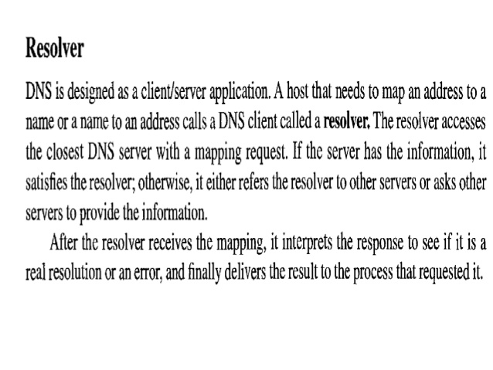

Slide 29
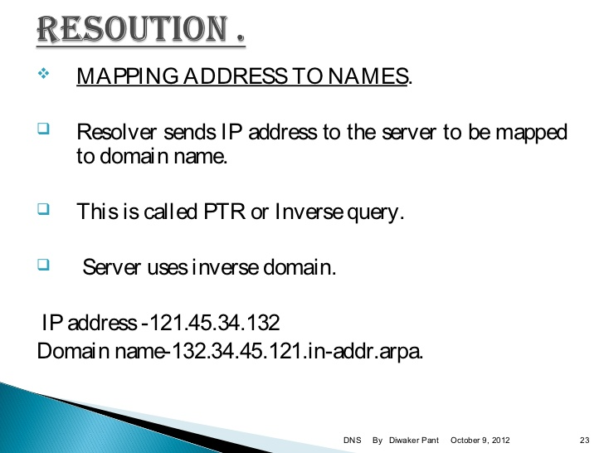

Slide 30
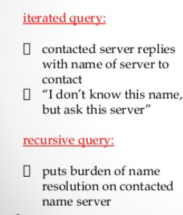

Slide 31
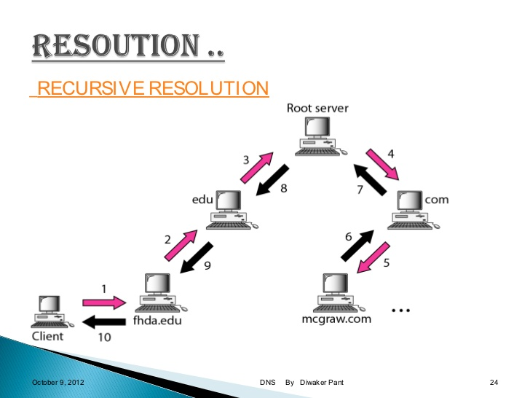

Slide 32
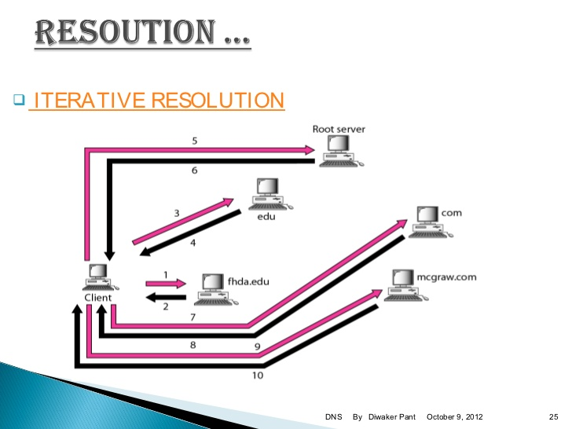

Slide 33
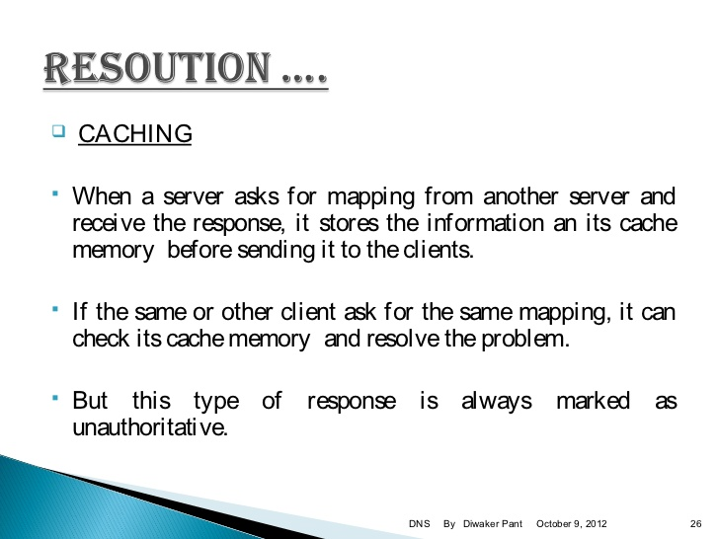

Slide 34
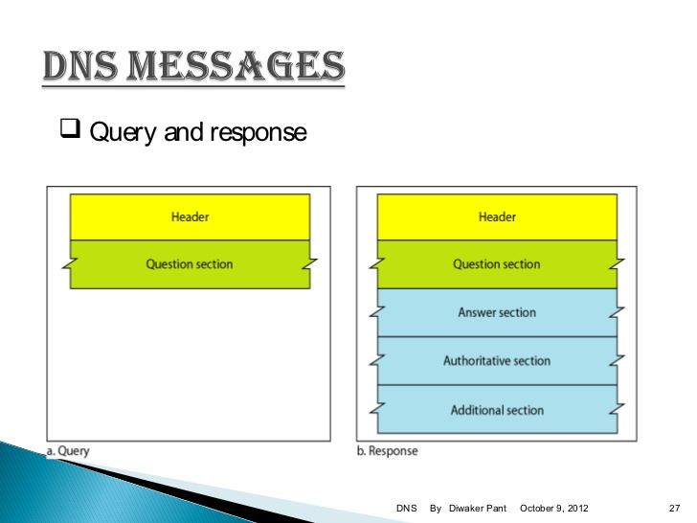

Slide 35
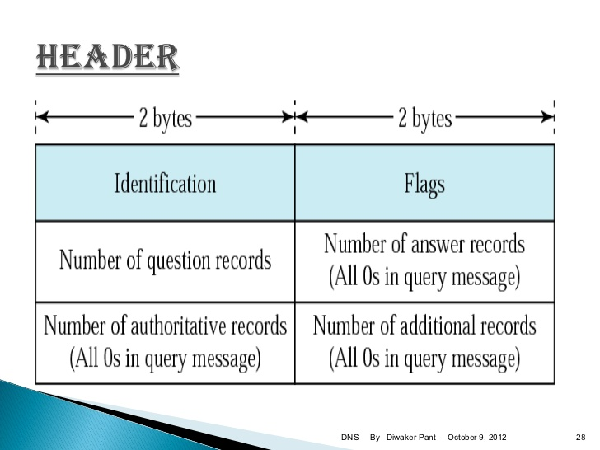

Slide 36
Identification:
This is a 16-bit field used by the client to match the response with the query.
The client uses a different identification number each time it sends a query.
The server duplicates this number in the corresponding response.

Slide 37
Flags: This is a 16-bit field consisting of the subfields such as
Type of message
Type of answer requested
Type of desired resolution

Slide 38
Number of Question Section:
This is a section consisting of one or more question records. It is present on both query and response messages.
number of Answer Section:
This is a section consisting of one or more resource records. It is present only on response messages. This section includes the answer from the server to the client (resolver).
number of Authoritative Section:
This is a section consisting of one or more resource records. It is present only on response messages. This section gives information (domain name) about one or more authoritative servers for the query.
Additional Information Section:
This is a section consisting of one or more resource records. It is present only on response messages. This section provides additional information that may help the resolver.

Slide 39
Types of Records
Question Record:
used by client to get information from a server.
Resource Record:
Each domain name is associated with a record called a resource record.
The server database consists of resource records
Is what is returned by the server to the client.

Slide 40
Registrar
To add a new domain to DNS done through registrar.
A commercial entity accredited by ICANN.
It first verifies that the required domain name is unique and then enters it into the DNS database.
A fee is charged.
Notes:
ICANN- Internet Corporation for Assigned Names and Numbers.

Slide 41
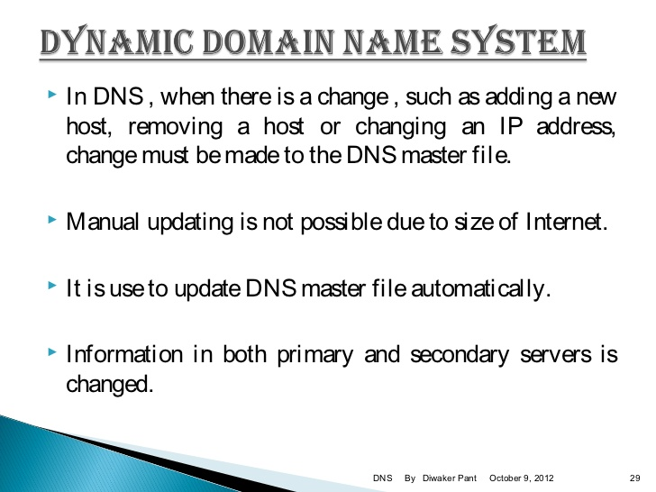

Slide 42
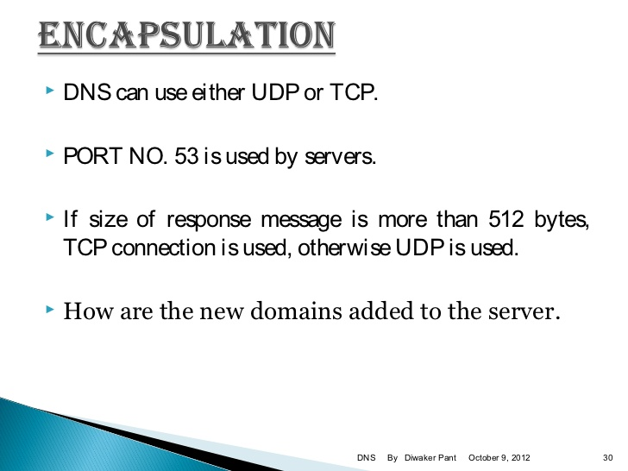

Slide 43
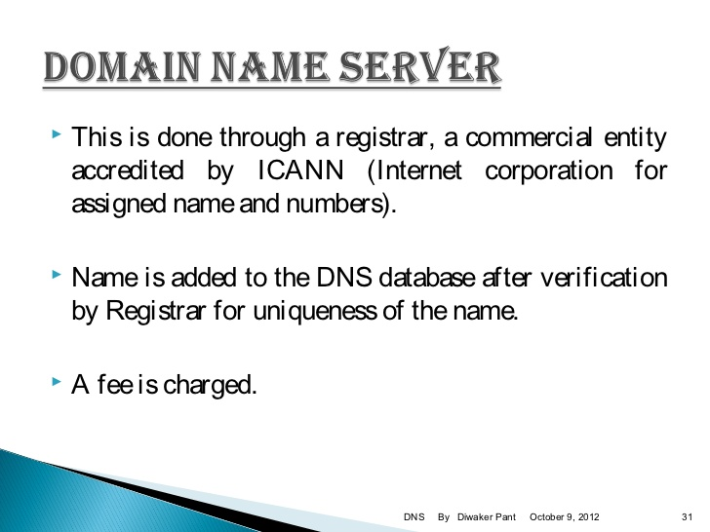

Slide 44
